Slide 1
4.2 Public-key cryptography
朱萍(Ping Zhu)
pzhubupt@gmail.com
School of Science, Beijing University of
Posts and Telecommunications

Slide 2
Private-key cryptography
Private-key cryptography
  traditional private/secret/single key cryptography uses one key.
  key is shared by both sender and receiver.
  if the key is disclosed, communications are compromised.
  also known as symmetric, both parties are equal
    hence does not protect sender from receiver forging a message

Slide 3
Public-key cryptography
Public-key cryptography
  probably most significant advance in the 3000 year history of cryptography
  uses two keys – a public key and a private key
  greatly reduces the number of keys needed to establish a communication network
  asymmetric since parties are not equal
  clever application of number theory concepts
Notes:
So far all the cryptosystems discussed have been private/secret/single key (symmetric) systems. All classical, and modern block and stream ciphers are of this form.

Slide 4
Public-key cryptography (cont.)
public-key/two-key/asymmetric cryptography involves the use of two keys:
  a public-key, which may be known by anybody, and can be used to encrypt messages, and verify signatures
  a private-key, known only to the recipient, used to decrypt messages, and sign (create) signatures
is asymmetric because
  those who encrypt messages or verify signatures cannot decrypt messages or create signatures
Notes:
So far all the cryptosystems discussed have been private/secret/single key (symmetric) systems. All classical, and modern block and stream ciphers are of this form.

Slide 5




Public-key cryptography (cont.)
public key
?
public key
private key
Bob
Alice
Notes:
So far all the cryptosystems discussed have been private/secret/single key (symmetric) systems. All classical, and modern block and stream ciphers are of this form.

Slide 6
Public-key cryptography (cont.)
Four concerns
  Confidentiality (保密性)
    A message sent from Alice to Bob cannot be read by anyone else
  Authenticity (真实性)
    Bob knows that only Alice could have sent the message that he has just received
  Integrity (完整性)
    Bob knows that the message from Alice has not been tampered with in transit
  Non-repudiation (不可否认性)
    It is impossible for Alice to turn around later deny the message she sent.

Slide 7
Public-key cryptography (cont.)
Public key gives an encrypting function E, and a private key gives a decrypting function D.
Requirement: D(E(m))=m for any message m
Any such system should be immune to a ciphertext-based attack in which the corresponding plaintext is also known.
For the system to be practical, one should be able to compute E(m) and D(E(m)) quickly, but for security, it should be impossible to determine D from E in any reasonable amount of time.

Slide 8
Trapdoor one-way function
Theoretically, a public-key system can be constructed by a special case of a one-way function known as a trapdoor one-way function (陷门单向函数).
Intuitively, a one-way function f should be one-to-one, and f(x) easy to compute for any x, but it should be difficult to solve the equation f(x)=y when y is known.
A trapdoor one-way function is one for which the equation f(x)=y becomes easy to solve if additional information (the trapdoor) is available.

Slide 9
Trapdoor one-way function (cont.)
No one has proved the existence of a one-way function. Two most likely candidates:
E.g. 1. Consider f(p, q) = pq, where p and q are prime numbers.
  f is easy to compute because multiplication takes time proportional to the product of the number of digits of p and q
  Computing the inverse of f is extremely difficult. There is no efficient method to determine p and q from n = pq.
  If p and q have 100 digits each, then for practical purposes, this is a one-way function.

Slide 10


Trapdoor one-way function (cont.)
E.g. 2. Consider , where g and n are two given integers.
  f is considered easy to compute because the number of steps needed to evaluate f is a polynomial function of the number of digits in the input x, g, and n.
  The problem of determining x from the knowledge of and g and n is known as the discrete-log problem.
  Despite considerable research, no method is known to evaluate the general discrete-log problem in polynomial time in the number of digits.

Slide 11
Three public-key systems
Three important public-key systems:
  RSA: Its security lies in the difficulty of the integer factoring problem.
  ElGamal: This method is based on the presumed intractability of the discrete logarithm problem.
  Elliptic Curve: The Elliptic Curve Cryptosystems are generalizations of the ElGamal system and are based on the difficulty of computing discrete logarithms in Elliptic Curves.

Slide 12
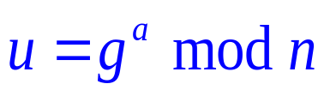
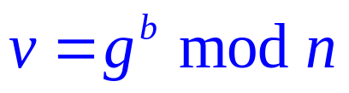
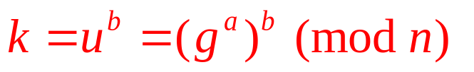
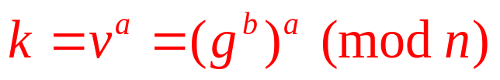
Key exchange protocol
The first application of public-key systems is to the problem of key exchange in secret-key systems.
Diffie and Hellman (1976): Suppose that Alice and Bob wish to exchange a secret key. They choose numbers g and n, which are made public.
  1. Alice chooses a random number a, computes and sends u to Bob.
  2. Bob chooses a random number b, computes
  and sends v to Alice.
  3. Bob computes the key
  4. Alice computes the key

Slide 13
Key exchange protocol (cont.)
Notice that Alice and Bob obtain the same key.
If g and n are chosen appropriately, then an intruder cannot determine k from the knowledge of u and v.
  To compute k, the intruder needs to know either a or b, and there is no known algorithm to accomplish this in a reasonable amount of time.

Slide 14
Key exchange protocol (cont.)
Diffie-Hellman key exchange protocol is susceptible to a man-in-the-middle attack.
  It is possible for Eve to intercept u and v and substitute her own u′ and v′.
This type of attack can be foiled by combining a key-exchange protocol with authentication and identification schemes.

Slide 15
Signature protocol
An important application of public-key systems is user authentication and message integrity.
E.g. Suppose a public-key system satisties E(D(m)) = m, in addition to D(E(m)) = m, (the latter is required for successful encryption and decryption). EA and EB: the public encryption keys of Alice and Bob; DA and DB: private keys. The basic signature protocol is:
  l . Alice encrypts the message m with her private key DA.
  2. Alice sends EB(DA(m)) to Bob.
  3. Bob recovers DA(m) with his private key and then recovers m using Alice's public key.

Slide 16
Signature protocol (cont.)
Since Bob can recover m, using Alice's public key, he is sure that only Alice could have sent it because only she knows her private key.
The security of the scheme derives from insensibility of computing DA from knowledge of EA.
The signature satisfies the following properties:
  Bob can verify that Alice sent the message because she signed it with her private key.
  The signature depends on the contents of the message, hence no one can use the signature with another document.

Slide 17
Signature protocol (cont.)
In practice, instead of signing the entire document, only a hash of the document is signed.
  The hash function of the document is a value that depends on the document. It is usually of fixed length, but the function is such that it is difficult to find two messages with the same hash function.
  In signature scheme, the hash function of a document is signed with the private key, and it can be verified by anyone using the public key.

